Slide 1
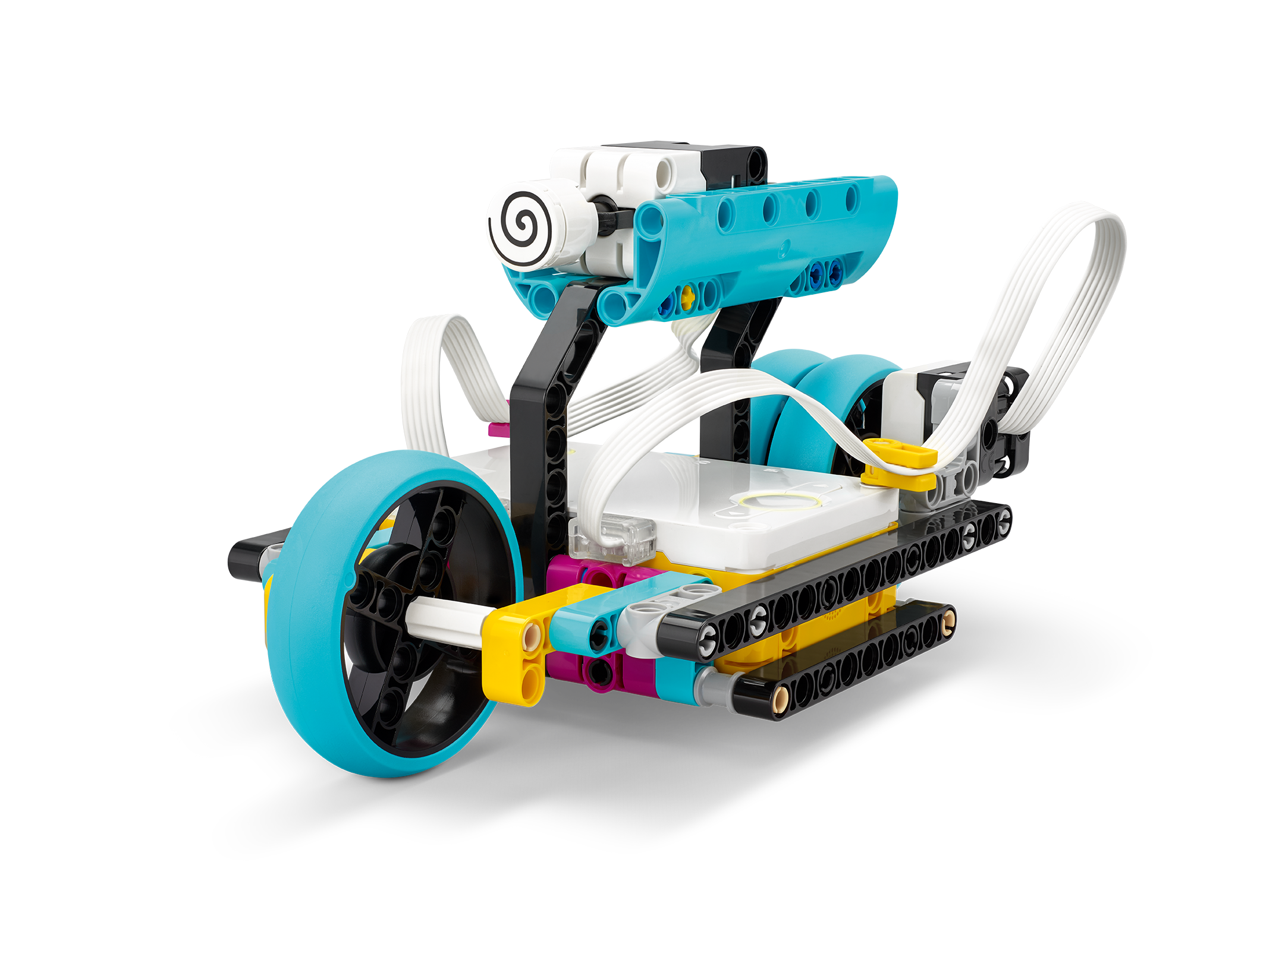
Aim For It
Explore kinetic energy using variable speed.
Inventor Notebook
Date: XX, Version: XX, Document Owner: XX, Total page number: XX

Slide 2
Engage
Have a look at the lesson:
https://education.lego.com/en-us/lessons/prime-training-trackers/aim-for-it/student-worksheet
Take notes of anything you’d like to remember.

Slide 3
Engage
Take a moment to answer these questions.
- What does the graph showing the distance traveled over time look like ?
- What does the graph showing speed over time look like?
- What does the graph showing kinetic energy over time look like?

Slide 4
Explain
Add a picture or video of your experiment.

Slide 5
Explain
Add a graph to document your results.

Slide 6
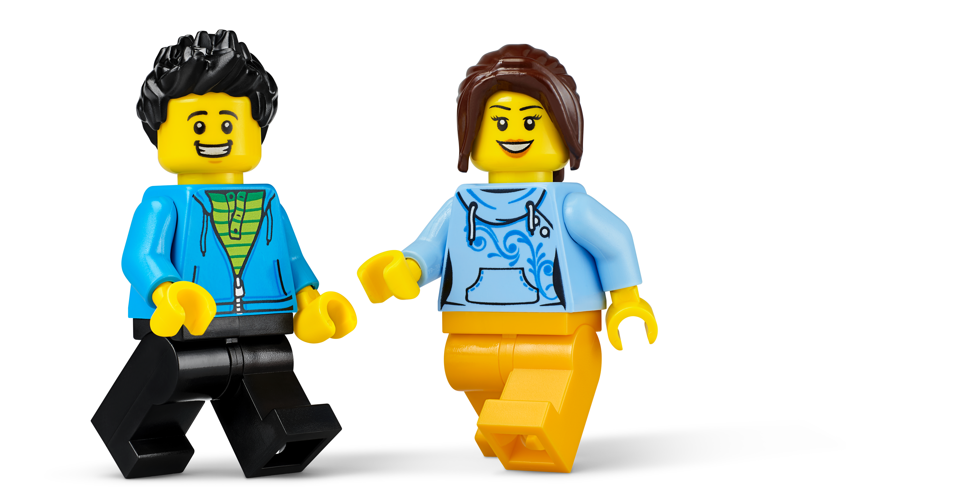
Evaluate
How would you summarize your experiment?

