Slide 1
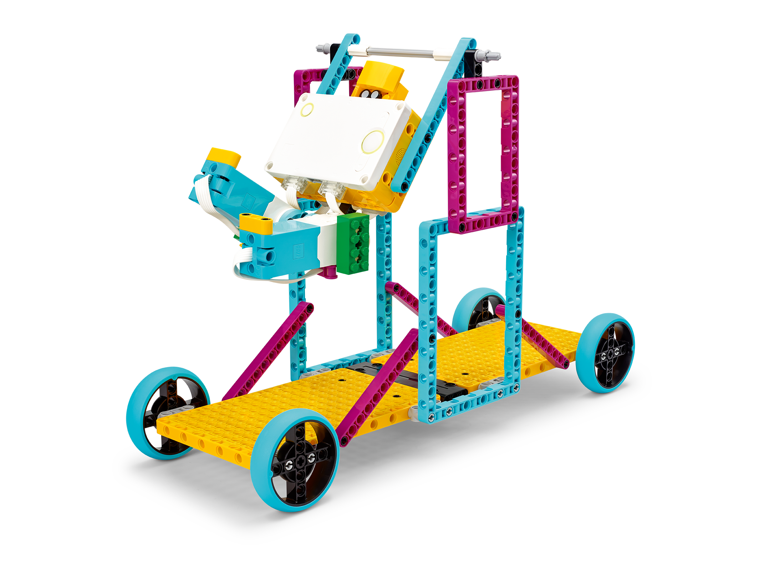
The Obstacle Course
Illustrate potential and kinetic energy transfer.
Inventor Notebook
Date: XX, Version: XX, Document Owner: XX, Total page number: XX

Slide 2
Engage
Have a look at the lesson:
https://education.lego.com/en-us/lessons/prime-training-trackers/the-obstacle-course/student-worksheet
Take notes of anything you’d like to remember.

Slide 3
Engage
Take a moment to answer these questions.
- How are kinetic and potential energy related?
- Do you know of any obstacle course games?

Slide 4
Explain
Add a picture or video of your experiment.

Slide 5
Explain
Add a graph to document your results.

Slide 6

Evaluate
How would you summarize your experiment?

