Slide 1
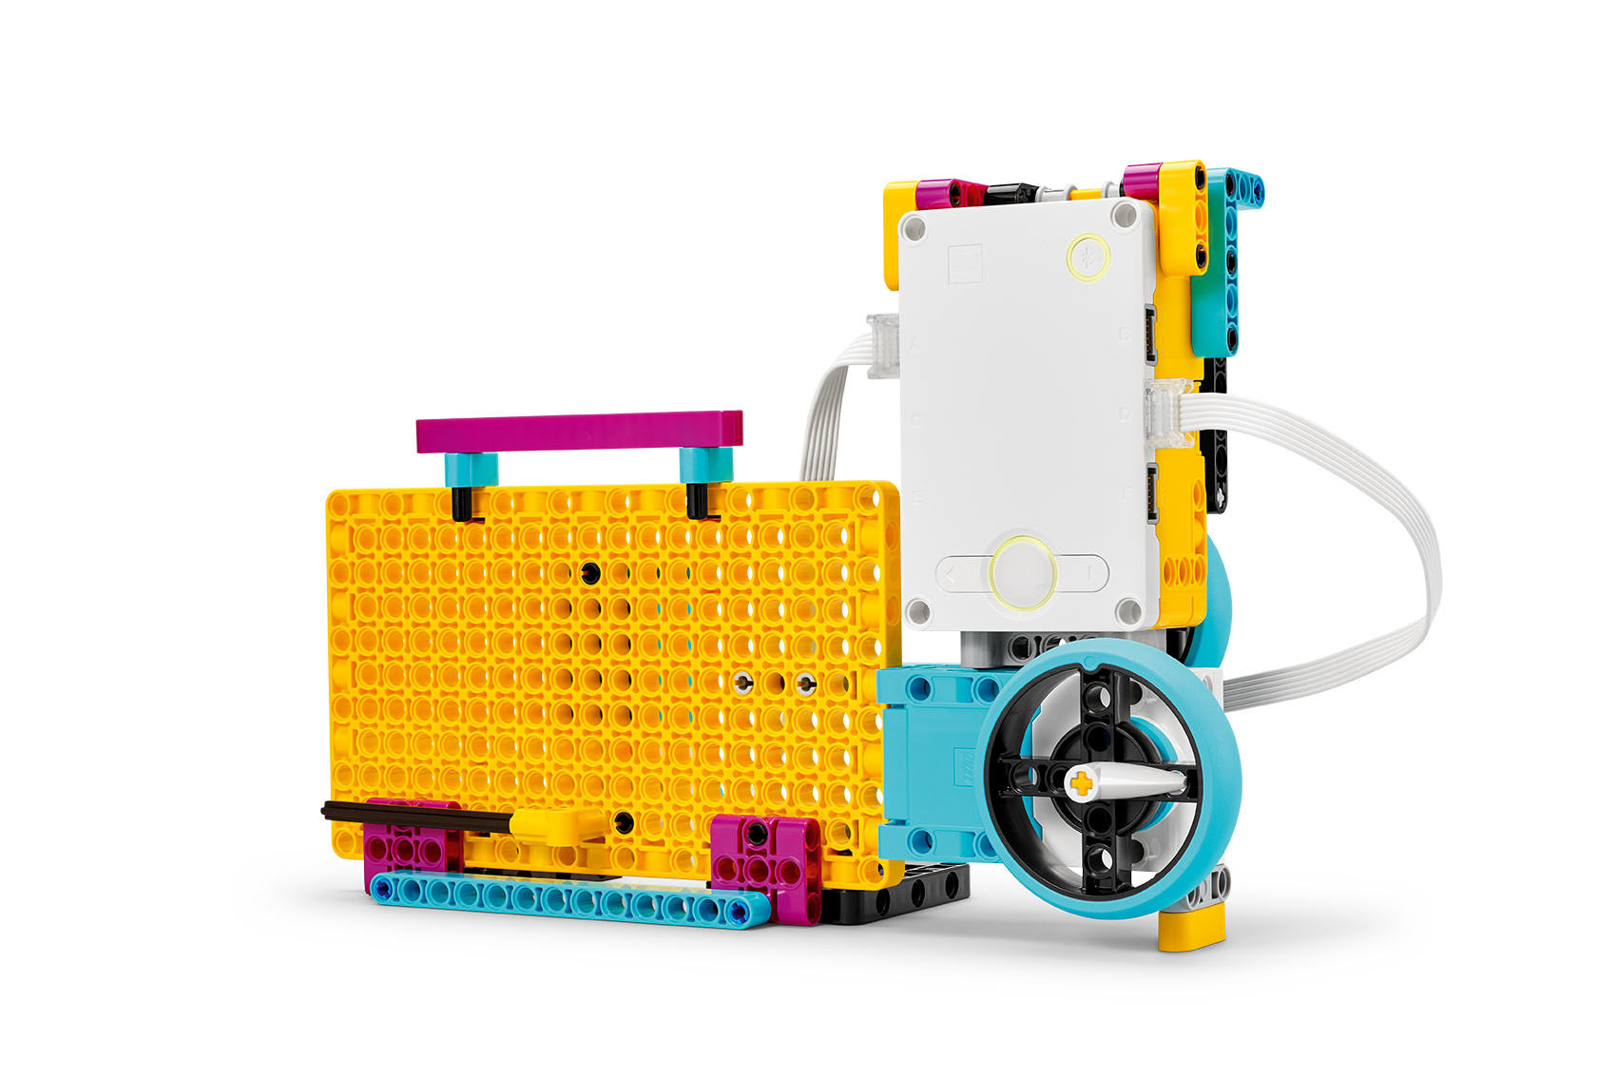
Watch Your Steps
EXPLORE Kinetic energy USING constant speed.
Inventor Notebook
Date: XX, Version: XX, Document Owner: XX, Total page number: XX

Slide 2
Engage
Have a look at the lesson:
https://education.lego.com/en-us/lessons/prime-training-trackers/watch-your-steps/student-worksheet
Take notes of anything you’d like to remember.

Slide 3
Engage
Take a moment to answer these questions.
- How can you measure how fast you're walking?
- How can you measure or calculate the energy of an object in motion?
- Which type of energy is that?

Slide 4
Explain
Add a picture or video of your experiment.

Slide 5
Explain
Add a graph to document your results.

Slide 6
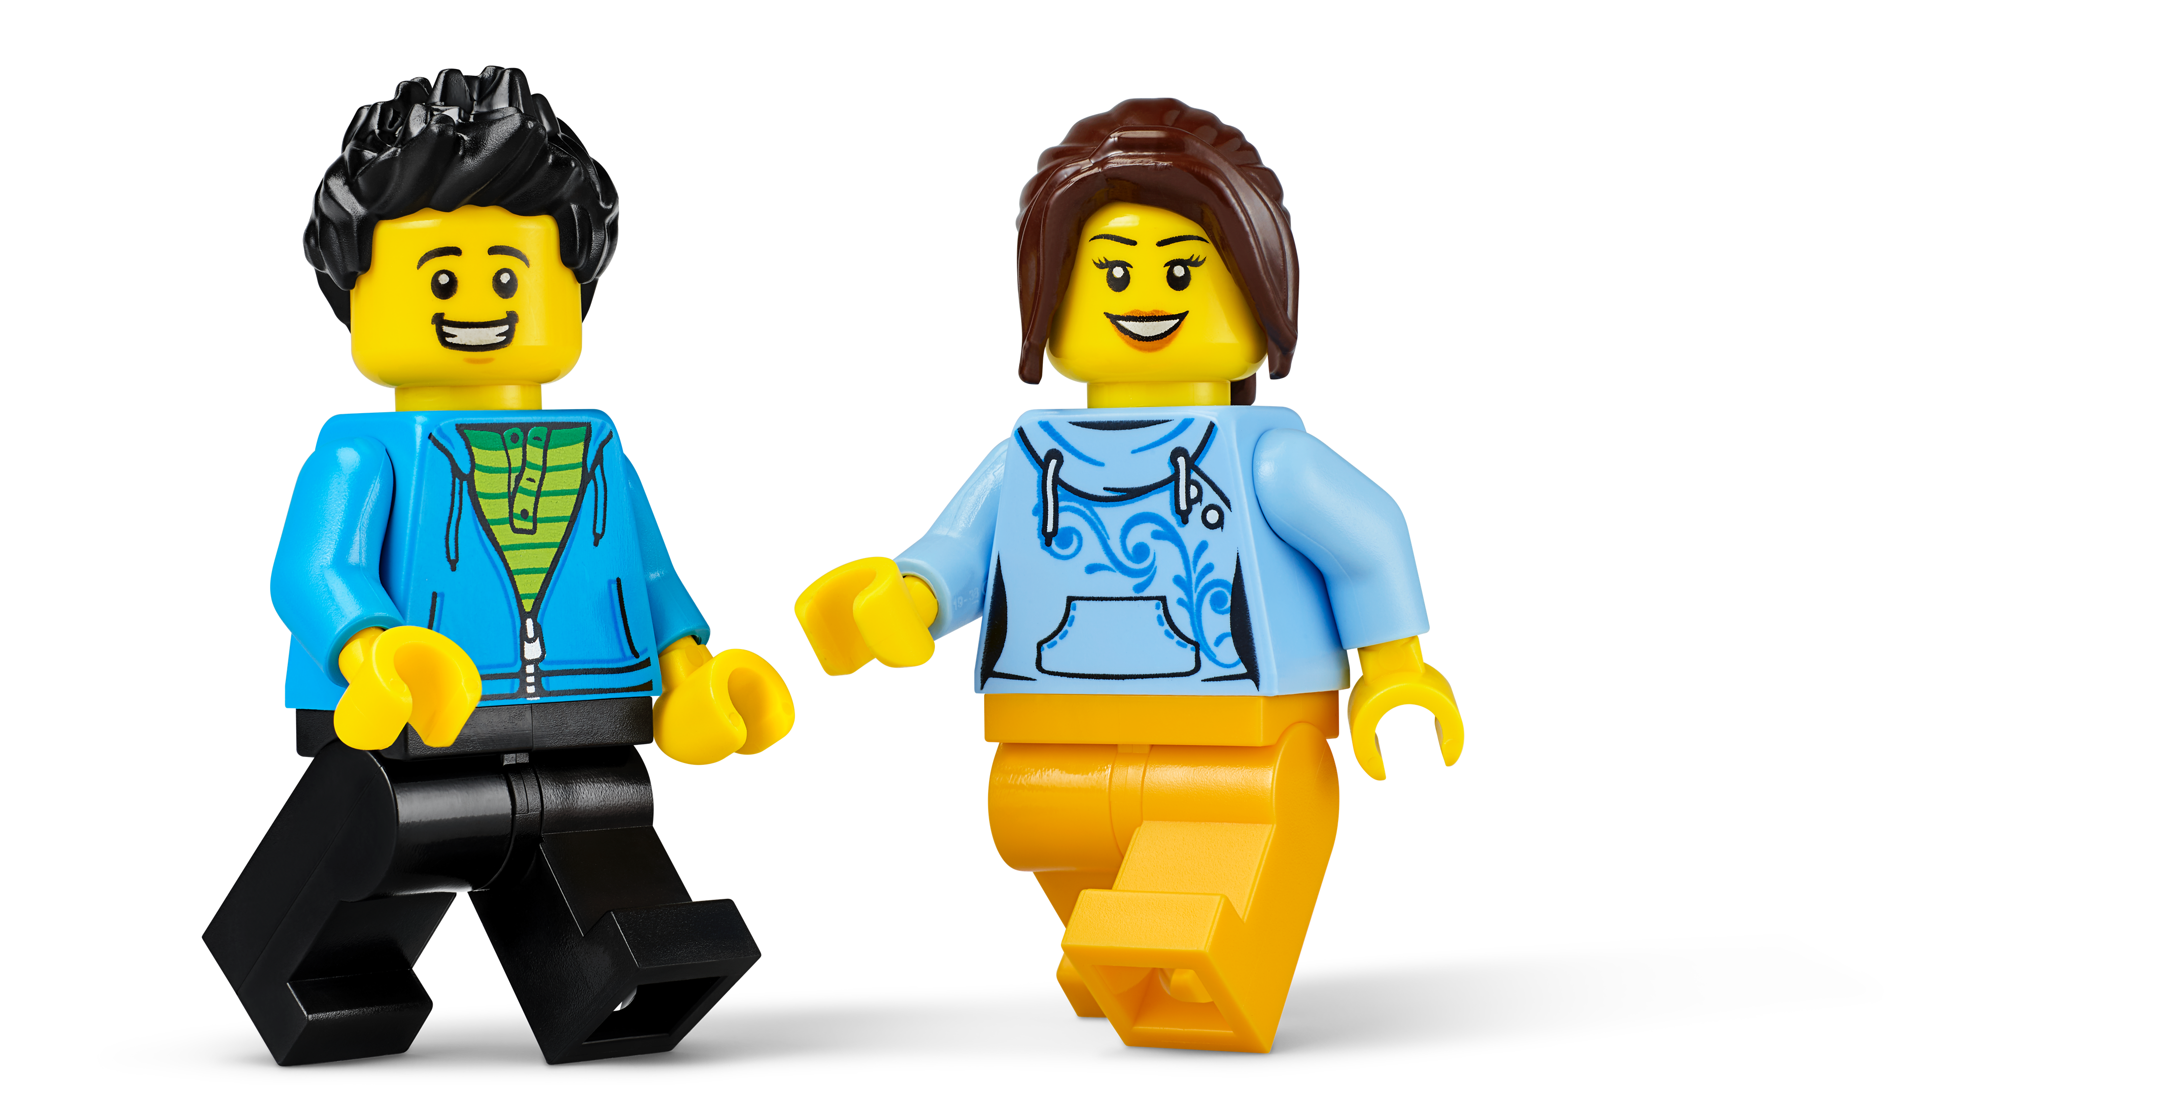
Evaluate
How would you summarize your experiment?

