Slide 1
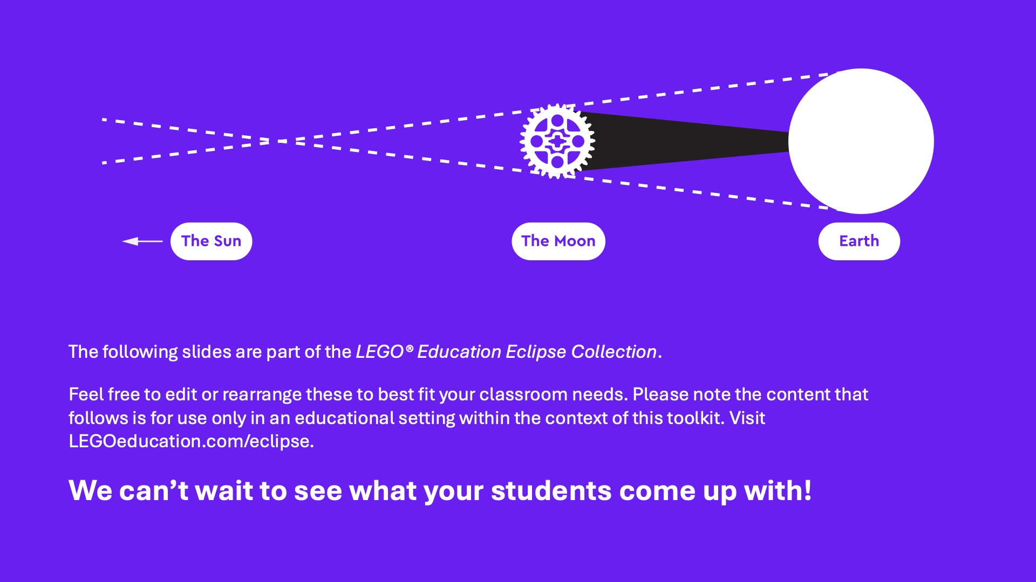

Slide 3
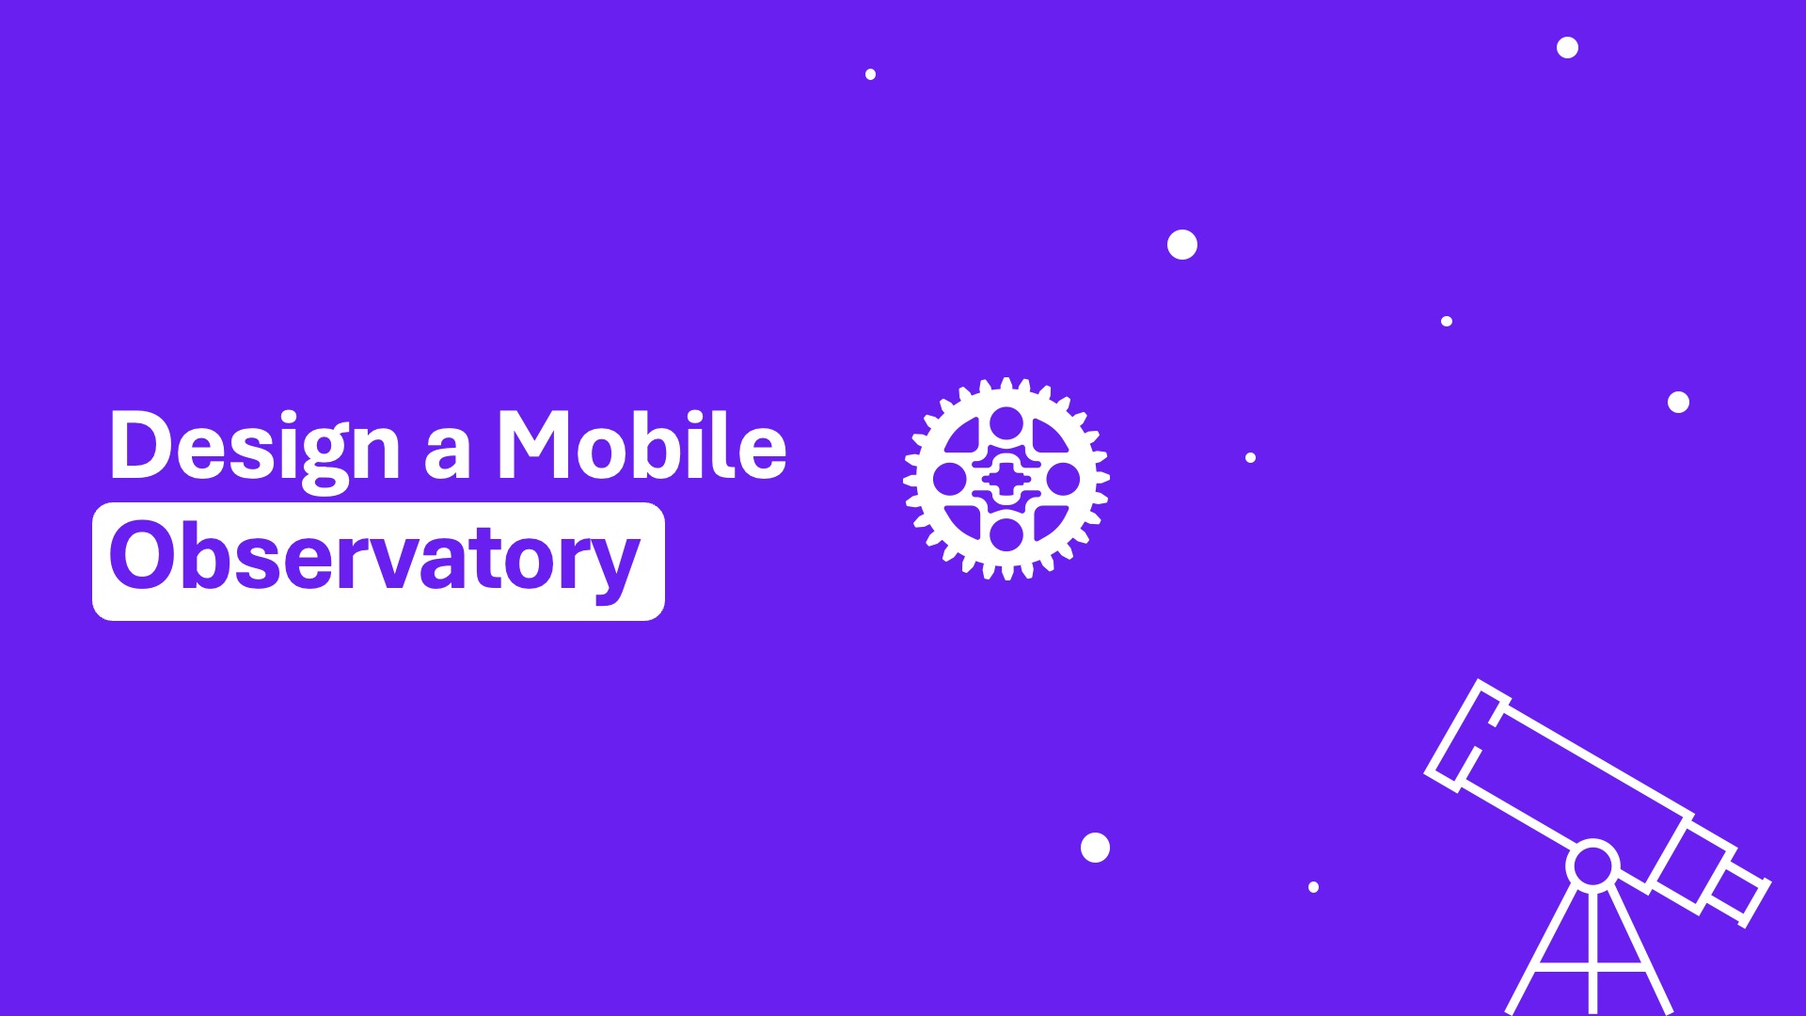

Slide 4
Design a Mobile Observatory
As a space enthusiast/observer or researcher, one challenge is creating a way to view natural phenomena, like a solar eclipse, on the go!
The path of totality for a solar eclipse does not happen all across the planet, but rather only in specific locations that scientists work hard to analyze and predict. When an eclipse occurs, if you want the best seat in the house, you may have to do some traveling! We need the right tool for the job!

Slide 5
It’s time to design a Mobile Observatory
Here are a few things to think about in your design:
Protective enclosure that can help protect the telescope from potential light pollution and environmental factors like rain, wind, and dust.
A platform on top of your vehicle or potentially being pulled by a trailer that can hold a telescope securely and rotate to move along with the path of the Sun and Moon.
Durability: Your mobile observatory may have to travel over a wide-range of different terrains and needs to be prepared for any obstacle.
Observing space is all about being prepared for anything, so we cannot wait to see what you come up with!

Slide 6
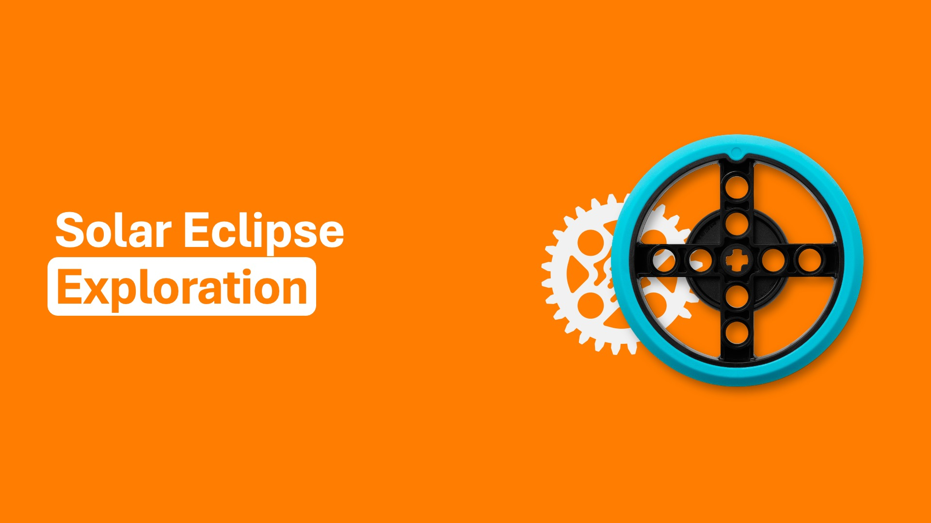

Slide 7
What is the Sun?
MISSION OBJECTIVE
Create a model of the Sun using the available materials.
QUESTIONS TO CONSIDER:
How did you make your model light up?
Did you have to rebuild some parts?
What was the most challenging part during this build?
What was the most successful part of this build?
MINI MISSION #1

Slide 8
What is the Moon?
MISSION OBJECTIVE
Create a model of the Moon using the available materials.
QUESTIONS TO CONSIDER:
How did you make your model orbit or show motion?
What was the most challenging part during this build?
What was the most successful part of this build?
MINI MISSION #2

Slide 9
Shadows and Eclipses
MISSION OBJECTIVE
Create a shape to cast a predetermined shadow on a piece of paper by blocking out light to explore the concept of shadows.
QUESTIONS TO CONSIDER:
How did you determine the distance of the objects?
Did the shape outline match the shape of your object blocking the light?
What was the most challenging part during this build?
What was the most successful part of this build?
MINI MISSION #3

Slide 10
Eclipse Safety
MISSION OBJECTIVE
Create a pinhole projector to project sunlight through the holes onto a surface and look at the solar image on the surface.
QUESTIONS TO CONSIDER:
Why did you make your model in the shape you did?
What was the most challenging part during this build?
What was the most successful part of this build?
MINI MISSION #4

