Slide 1
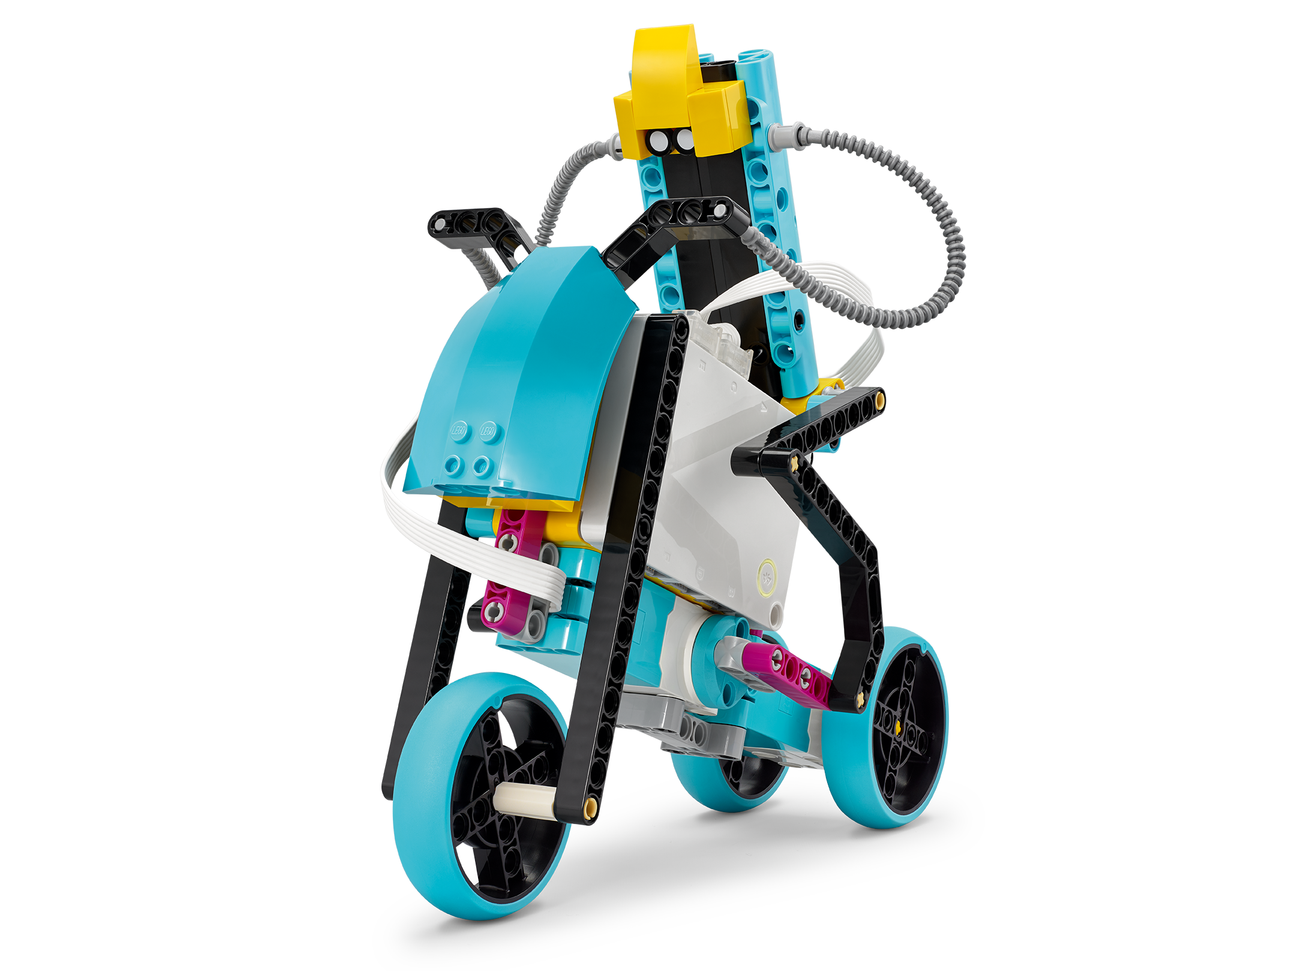
This Is Uphill
Graph energy consumption to gain potential energy.
Inventor Notebook
Date: XX, Version: XX, Document Owner: XX, Total page number: XX

Slide 2
Engage
Have a look at the lesson:
https://education.lego.com/en-us/lessons/prime-training-trackers/this-is-uphill/student-worksheet
Take notes of anything you’d like to remember.

Slide 3
Engage
Take a moment to answer these questions.
- What will happen to your speed when you go up a hill?
- What type of energy do you gain as you’re going up a hill?
- What do you need to do to maintain a consistent energy level as you ride a bike (your system)?
- Why do you think that's the case?

Slide 4
Explain
Add a picture or video of your experiment.

Slide 5
Explain
Add a graph to document your results.

Slide 6
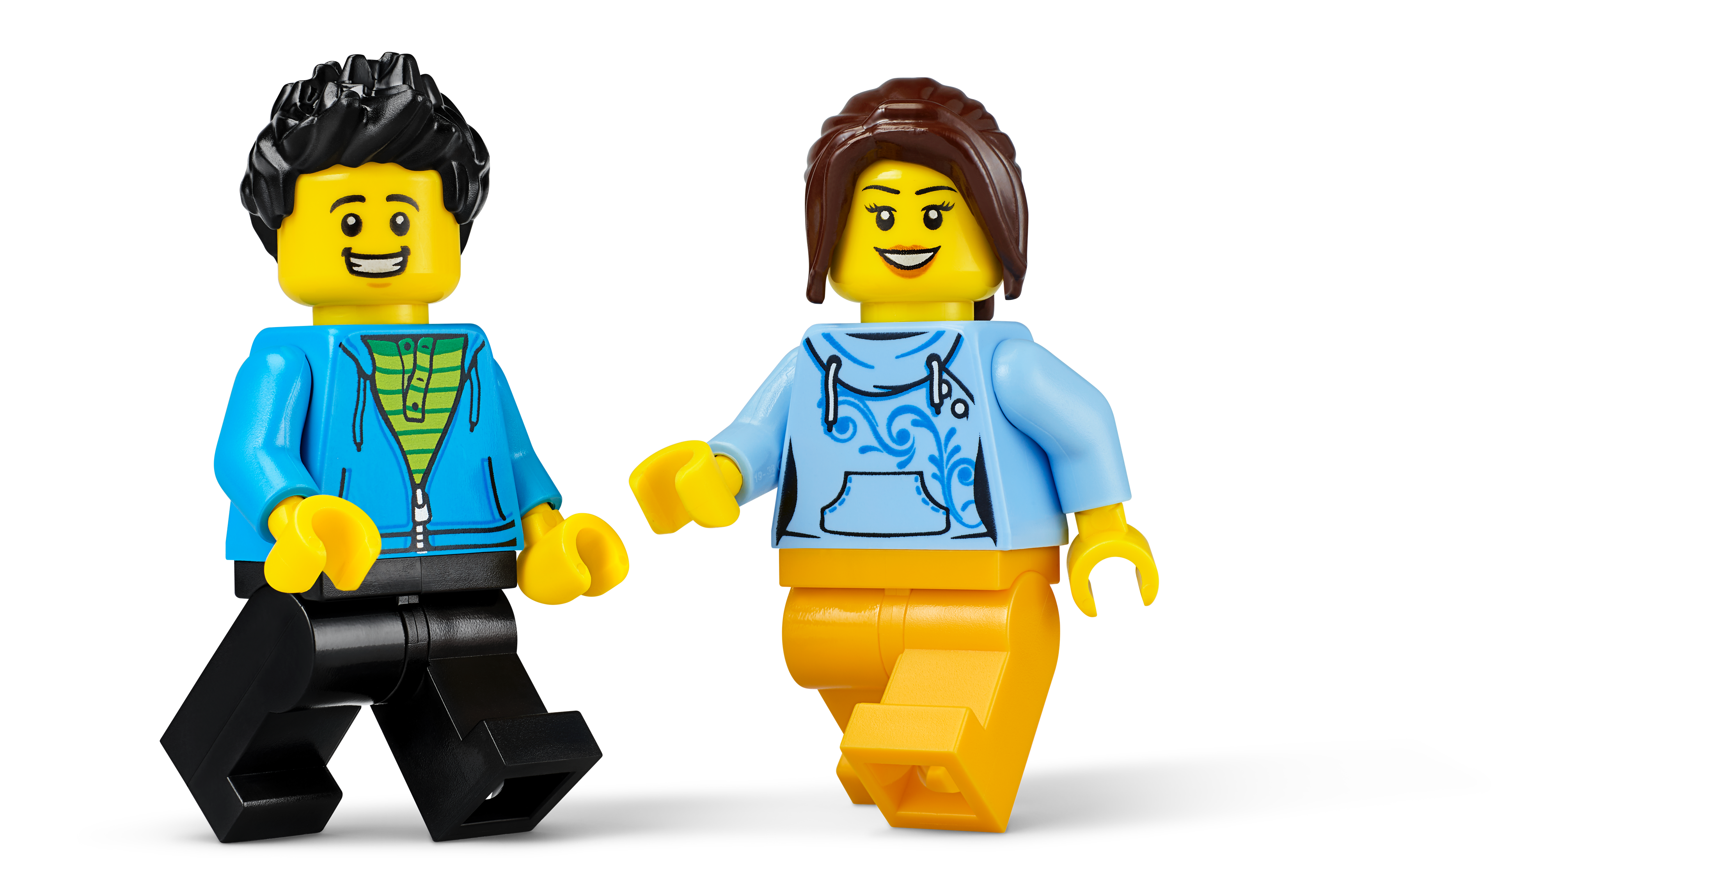
Evaluate
How would you summarize your experiment?

