Slide 1
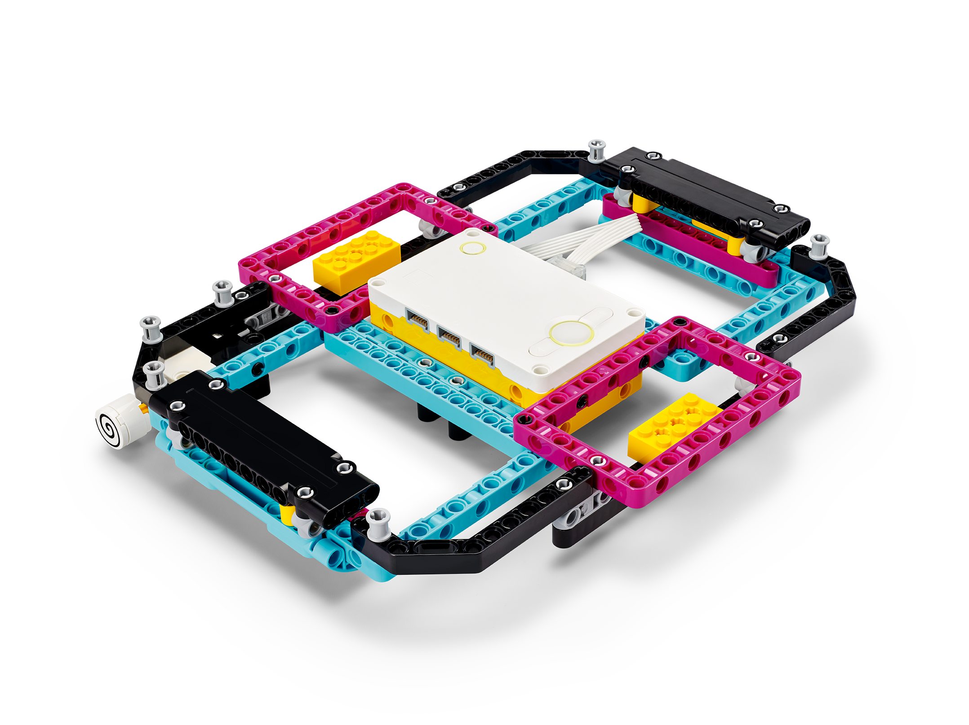
Stretch with Data
Match graph values and explore margins of error qualitatively.
Inventor Notebook
Date: XX, Version: XX, Document Owner: XX, Total page number: XX

Slide 2
Engage
Have a look at the lesson:
https://education.lego.com/en-us/lessons/prime-training-trackers/stretch-with-data/student-worksheet
Take notes of anything you’d like to remember.

Slide 3
Engage
Take a moment to answer these questions.
- What are some ways of determining whether or not a movement is precise?
- How could you graph values to represent real-life movement?

Slide 4
Explain
Add a picture or video of your experiment.

Slide 5
Explain
Add a graph to document your results.

Slide 6
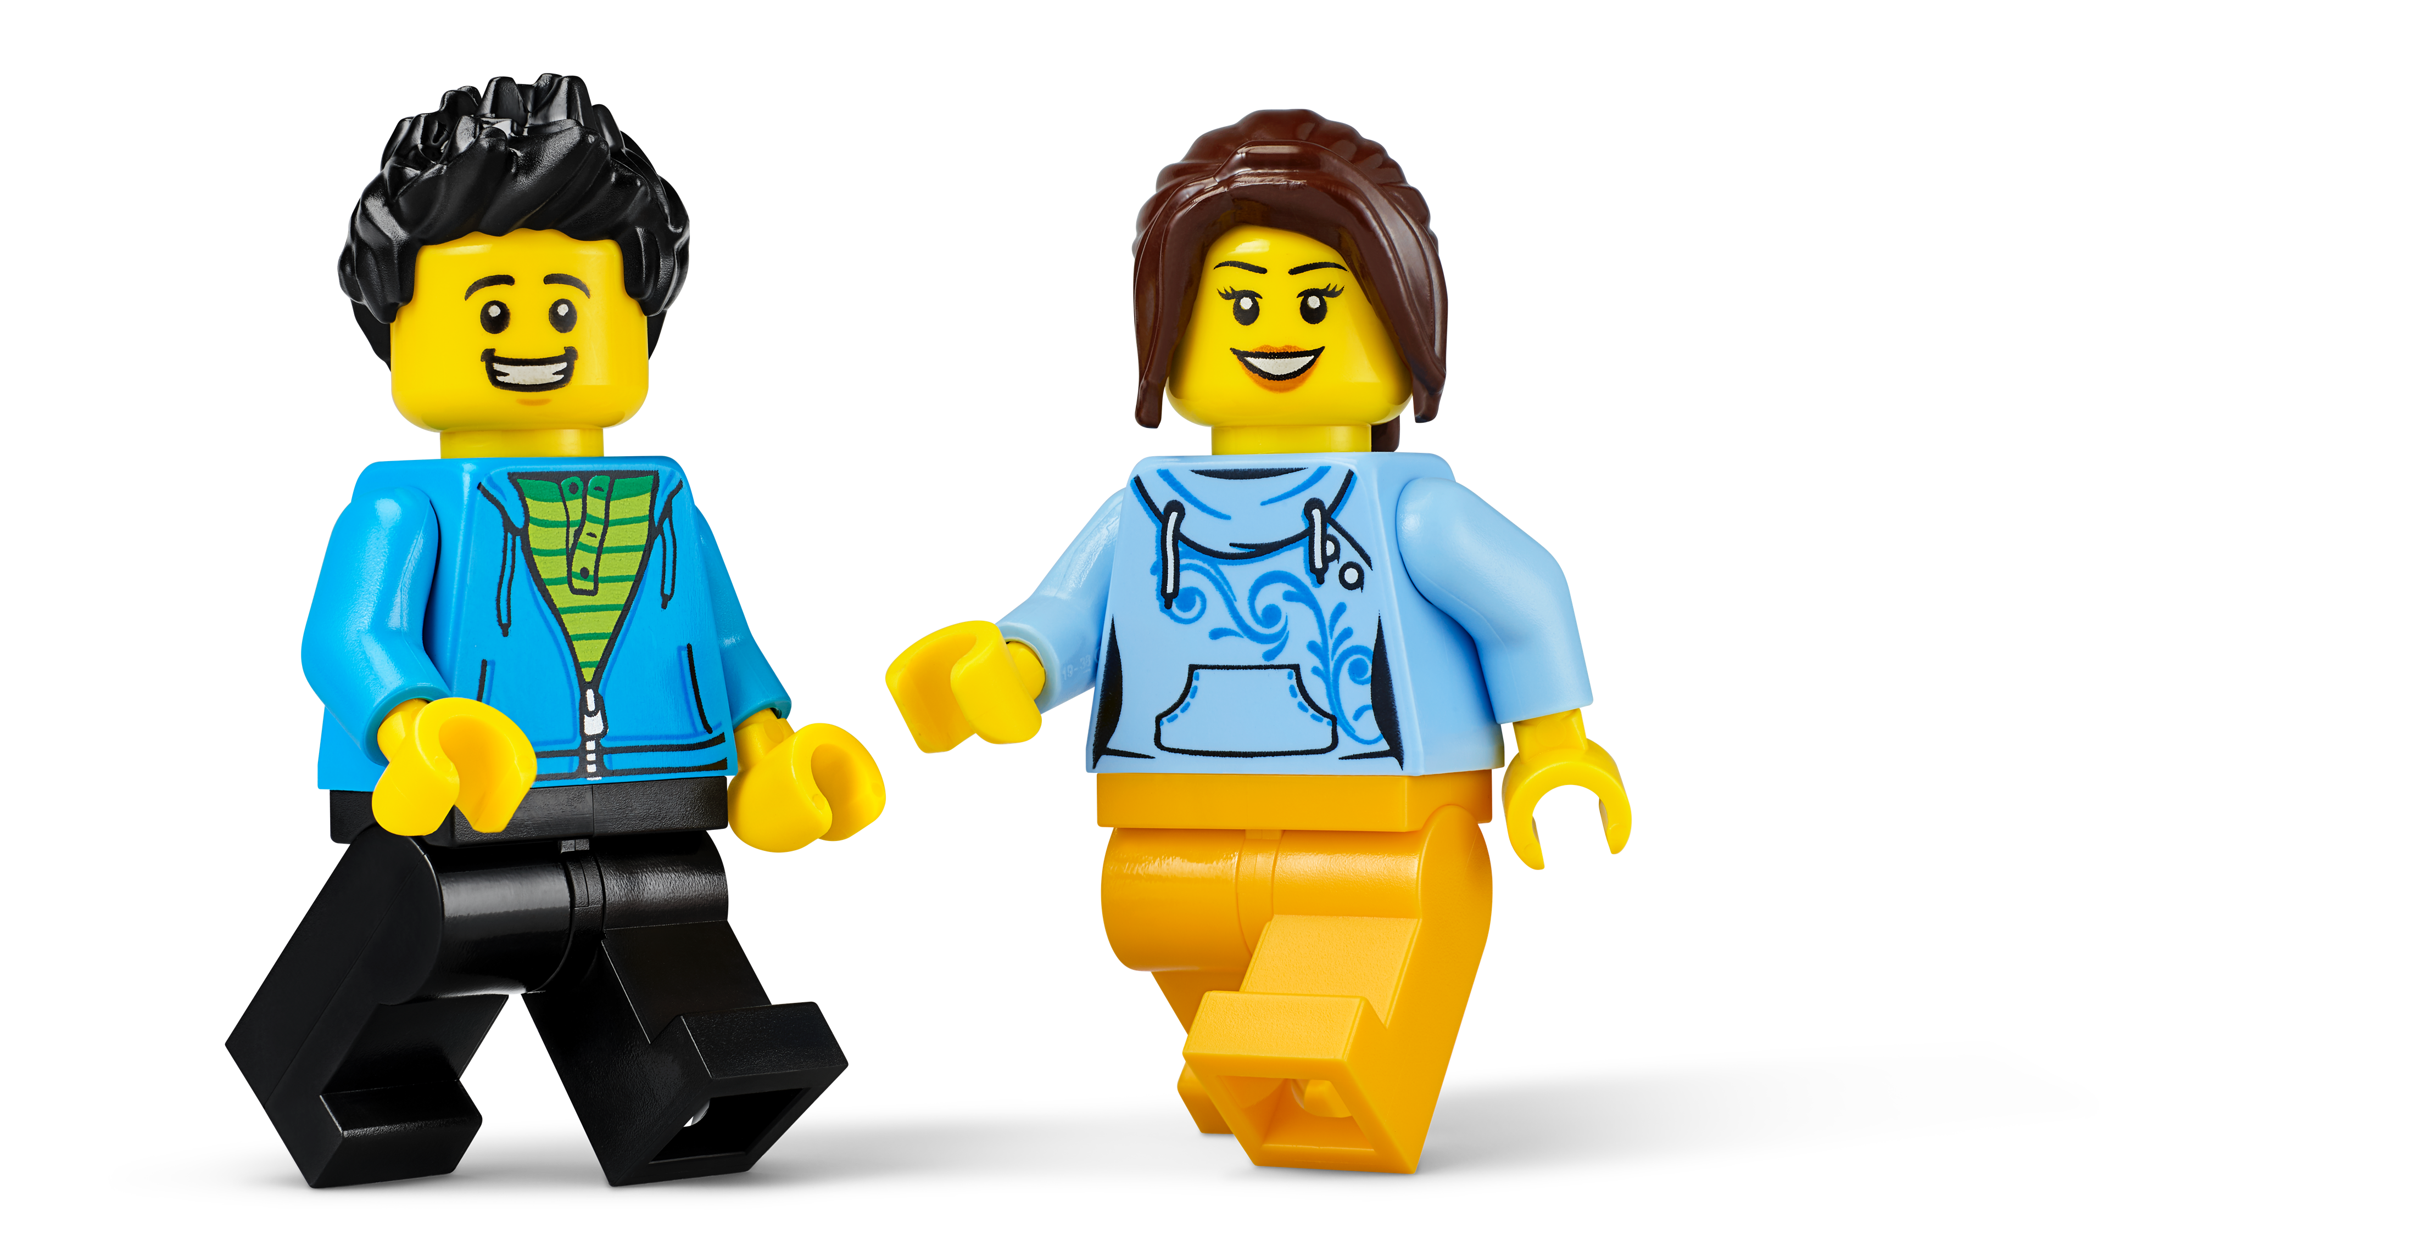
Evaluate
How would you summarize your experiment?

